Slide 1
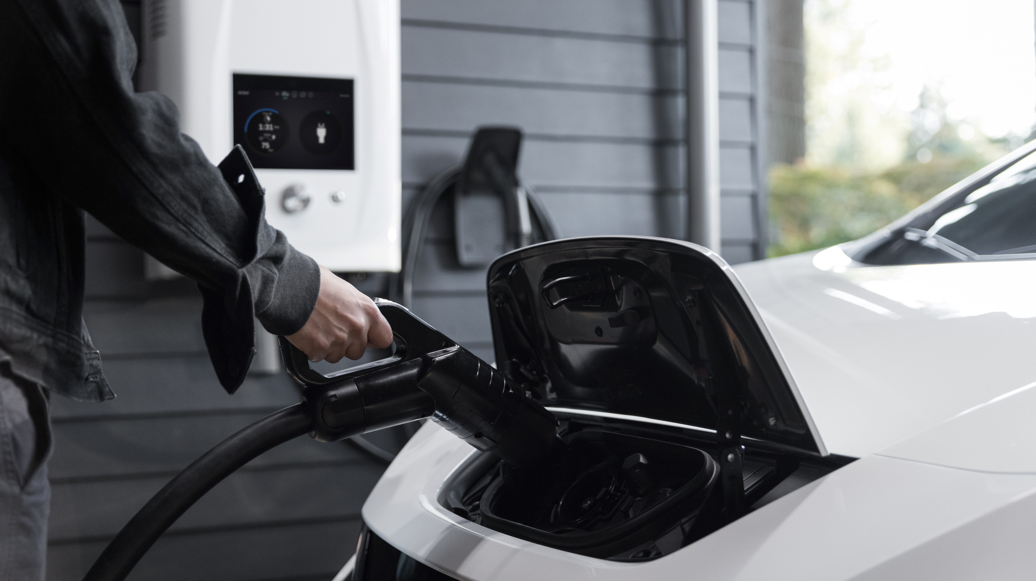
Towards the Implementation of an Accurate HEV Battery Model in EMTP-RV
By: Shankar Ramharack Date: 17.07.2022

Slide 2
Contents
Selected Battery Model
Required parameters to use Battery Model
Use of locally available EV Data
Implementing Battery Model in EMTP-RV
Limitation and SOEs of current approach
Projected Timeline
Conclusion

Slide 3
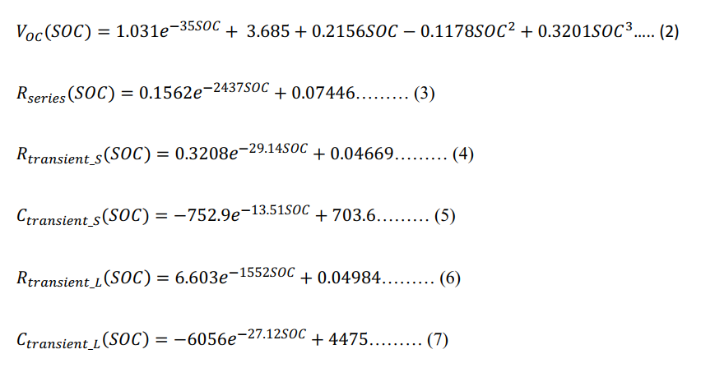
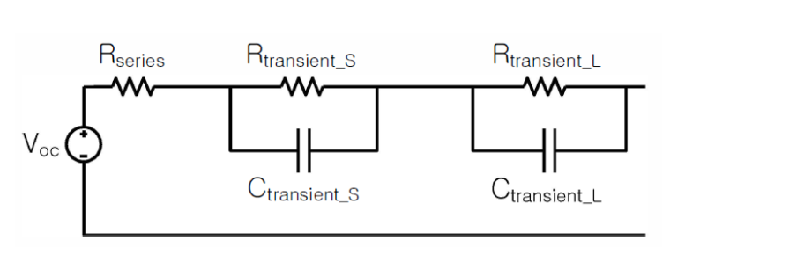

Selected Battery Model

Slide 4
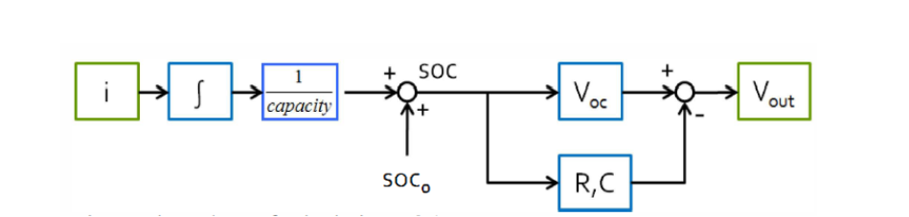
Required Parameters to use Battery Model
The equivalent circuit is dependent on the SOC as observed by the BMS.
The SOC is analytically related to the current vs time
The charge rating of the battery is fixed
Essentially the entire model depends on determining the SOC from the current vs time data. Hence the main requirement is the current vs time characteristic curve for the battery.

Slide 5
Use of locally available HEV Data
Mr. Clarence Ramai has developed a device capable of collecting data from Hyundai Ioniqs which can be used to collect SOC, SOH, Cumulative current, battery voltage, etc.
The characteristic current vs time vs SOC can be obtained from Dr. Bahadoorsingh’s Ioniq
The SOC model can be validated against the collected data

Slide 6
Implementing Battery Model in EMTP-RV
The equations describing the RLC components can be used to make the values dependent on SOC
The SOC can be implemented as a reference to a current and time variable
The current vs time graph can be obtained by fitting a polynomial
Battery model can be distilled into a standalone block

Slide 7
Limitations and SOE of Approach
Newer batteries may not follow the clean equations used to relate the equivalent circuit to SOC
The Voc vs SOC as a blackbox may be easier and more accurate to implement rather than trying to estimate RLC parameters of an equivalent circuit
The current approach will utilize data from a used Hyundai Ioniq which may paint a biased picture of battery characteristics
The collected data may have missing data points limiting the accuracy

Slide 8
Projected Timeline
Period | Objective
17.07 – 22.07 | Research implementing approach in EMTP-RV
23.07-24.07 | Collect charging data from Dr. Bahadoorsingh’s Ioniq
25.07 – 31.07 | Implement approach in EMTP-RV
01.08 – 07.08 | Brainstorm charger implementation

Slide 9
Conclusion
Battery model is dependent on current and time
Data is available to implement model in EMTP-RV
Validation of model is available using local data

